Slide 1

Capstone Project II
Cohort-09
Data-Analytics
Prepared by: Rana Sheraz Shafi

Slide 2


EDA &
STATISTICAL
ANALYSIS
USING PYTHON
Presentation - 2024
Visit Our Website
https://ranasherazshafi.carrd.co/

Slide 3

About DataSet :
BRFSS
Behavioral Risk Factor Surveillance System
It's a health survey data, conducted by the Centers for Disease Control and Prevention (CDC) and state health departments, that gathers health-related data from U.S. residents regarding their health-related risk behaviors, chronic health conditions, and use of preventive services.

Slide 4

Objectives
Understand the prevalence and distribution of chronic diseases such as Heart Deceases, Diabetes & Arthritis among different people of Washington with different age groups, and genders.
Examine health behaviors such as smoking, alcohol consumption, physical activity, and dietary habits to identify patterns and trends in unhealthy behaviors.
Company Mission

Slide 5



Step by Step:
How I approached this Project?
Pre Processing
Exploratory Data Analysis
Hypothesis Test
Regression
Conclusion

Slide 6

Data Preprocessing
Loaded data
Looked for variables
Removed unwanted variables and rows(filtered on basis of State)
Renamed columns for better readability and understanding
Checked the types and distributions of selected variables.
Checked correlations between different variables using correlation matrix.

Slide 7

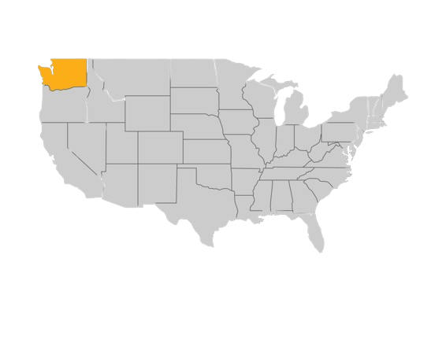
Washington

Slide 8
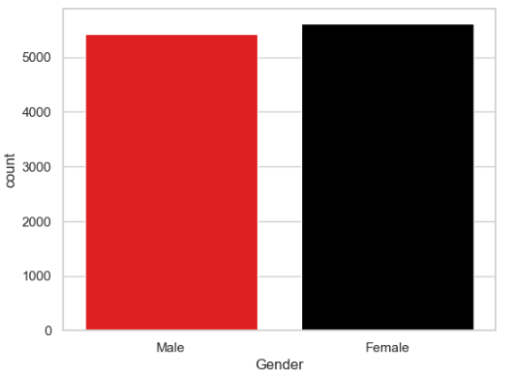
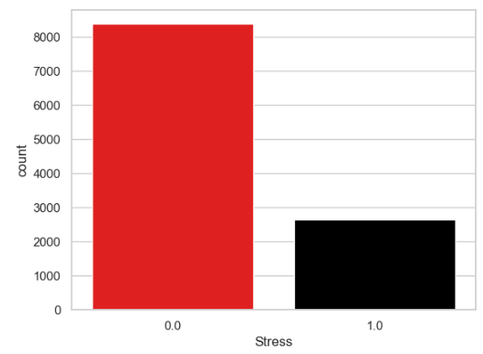
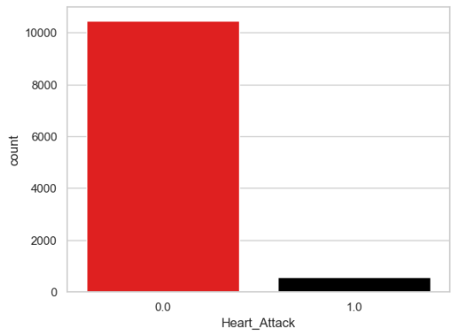
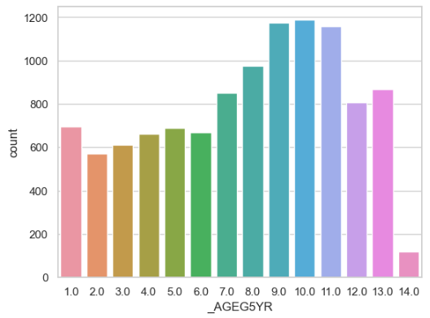
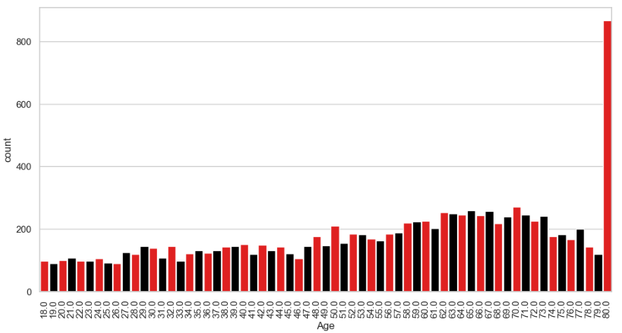
0.0 No
1.0 Yes
0.0 No
1.0 Yes

Slide 9
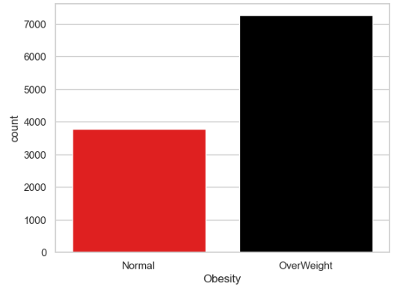
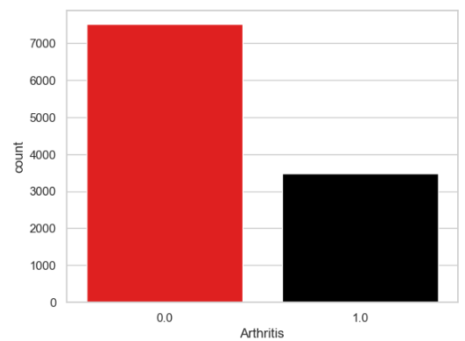
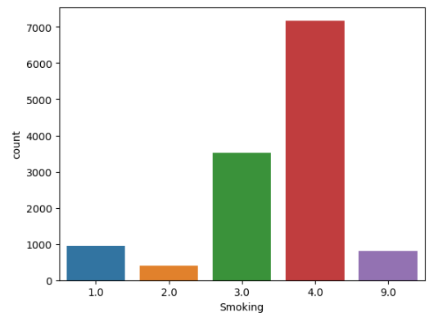
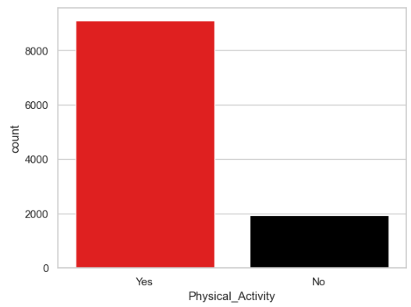
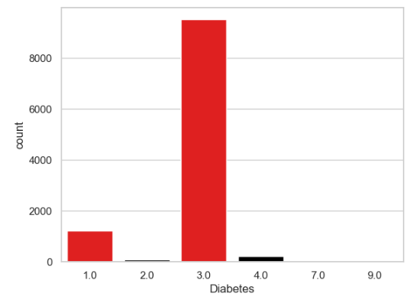
0.0 No
1.0 Yes
1.0 Everyday Smoker
2.0 Someday Smoker 3.0 Former Smoker
4.0 Non Smoker
5.0 Don’t Know
1.0 Diabetic
2.0 Female with Diabetes (pregnancy)
3.0 Non - Diabetic
4.0 Pre - Diabetic
7.0 Don’t Know
9.0 Missing

Slide 10
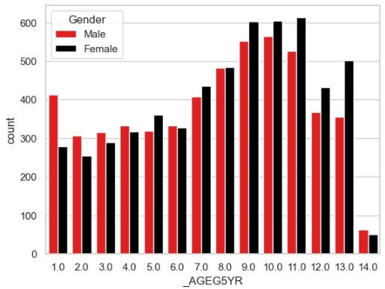
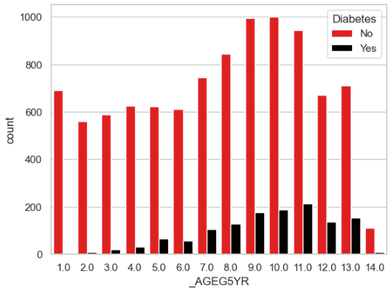
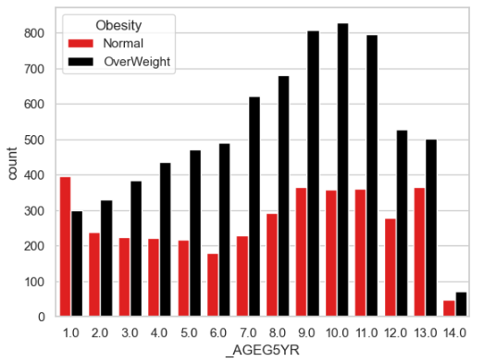
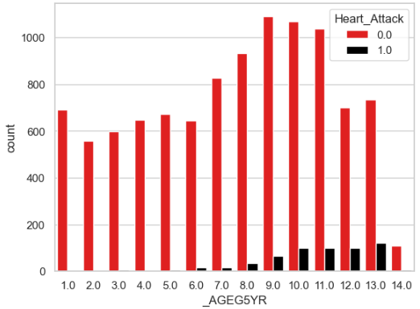
Change in different variables with Age:

Slide 11
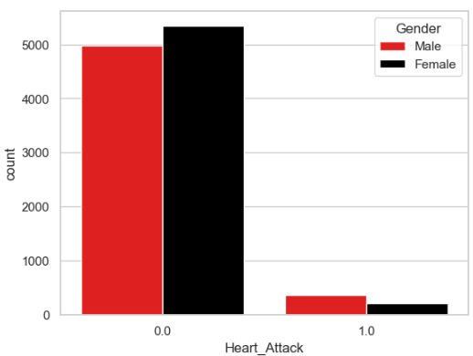
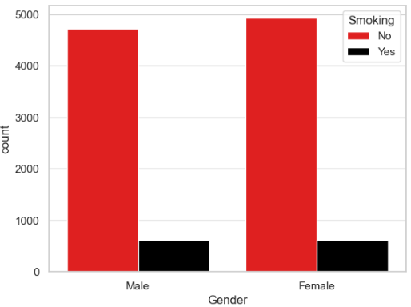
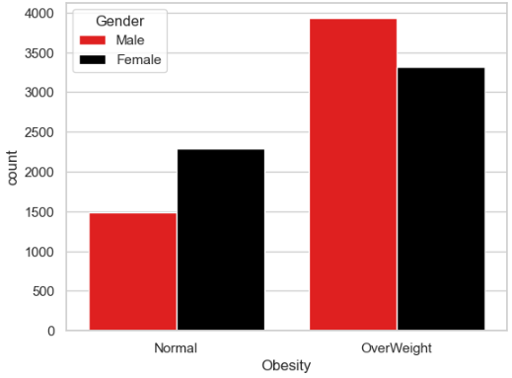
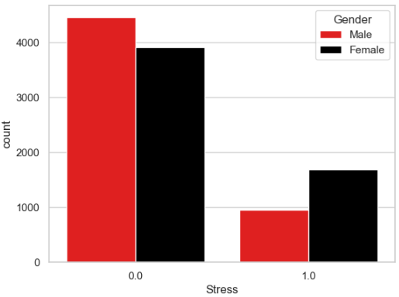
Gender based comparison:

Slide 12
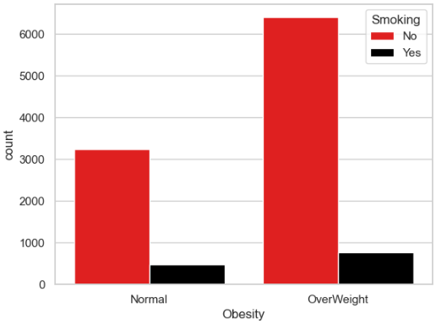
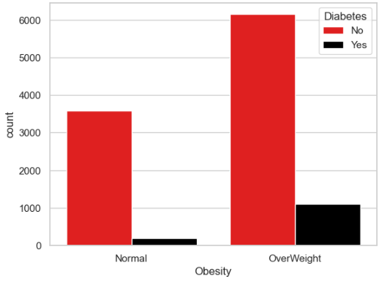

Slide 13
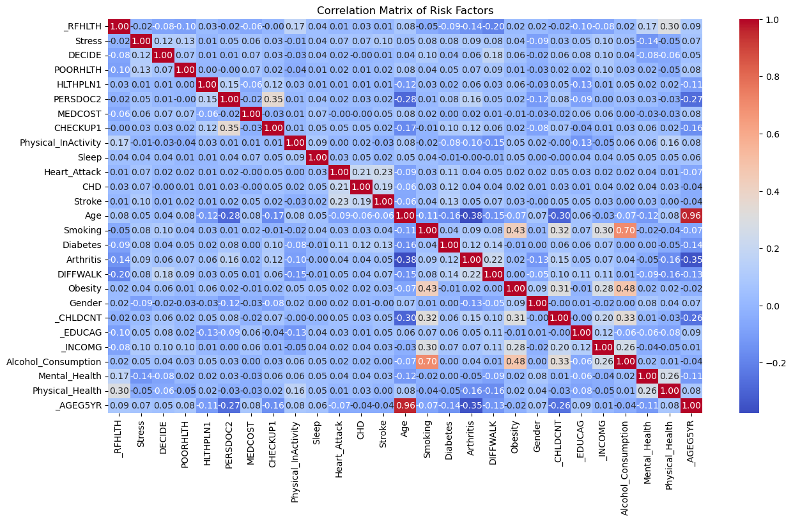

Slide 14
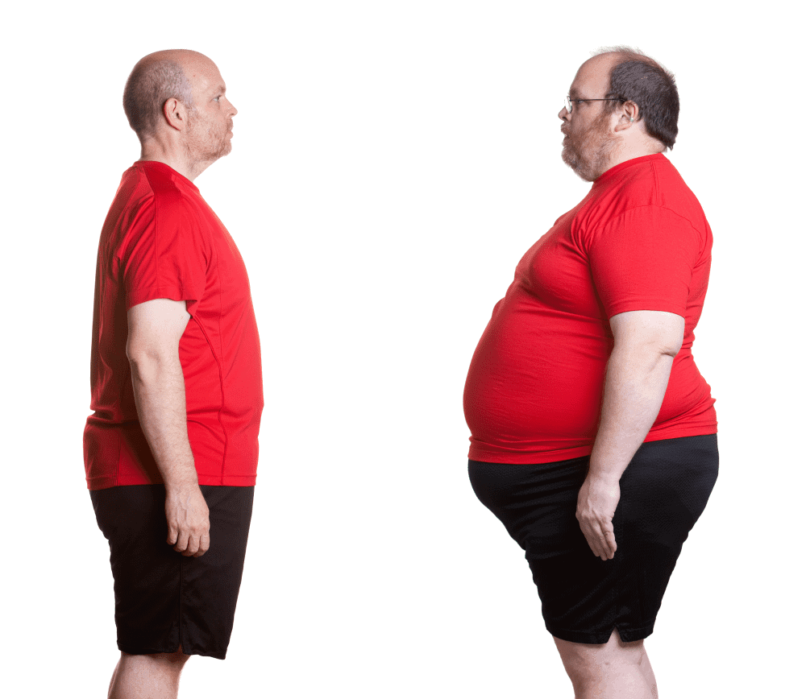
Hypothesis : 1
Impact of Physical Inactivity on Obesity
Null Hypothesis:
Alternate Hypothesis:
Physical inactivity does not significantly affect obesity status.
Individuals who are physically inactive are more likely to be obese.

Slide 15
Approach: Since both of our variables were Categorical
Chi-Square Test
Value: 77.15
Null-Hypothesis Rejected
P-Value:
1.5811792409021849e-18
<0.05

Slide 16

Hypothesis : 2
Smoking and Heart Attack Incidence
Null Hypothesis:
Alternate Hypothesis:
Smoking status does not influence the incidence of heart attacks.
Smokers have a higher incidence of heart attacks compared to non-smokers

Slide 17

Approach: Since both of our variables were Categorical
Chi-Square Test
Chi-Square value: 108
P-Value:
2.236698697364754e-23 <0.05
Null-Hypothesis Rejected

Slide 18
Hypothesis : 3
Influence of Age on Arthritis Prevalence
Null Hypothesis:
Alternate Hypothesis:
Age does not have a significant effect on the prevalence of arthritis
Older individuals are more likely to suffer from arthritis.

Slide 19
Approach: Since both of our variables were Categorical
Chi-Square Test
Value: 1493.66
Null-Hypothesis Rejected
P-Value:
1.00486642939e-311 < 0.05

Slide 20
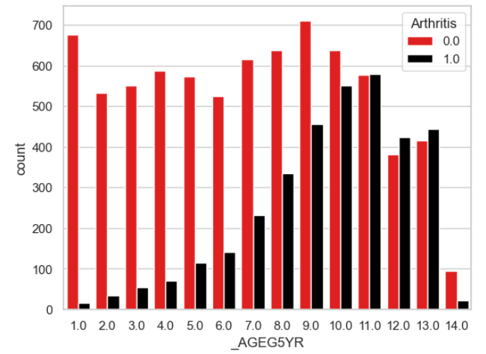

Slide 21
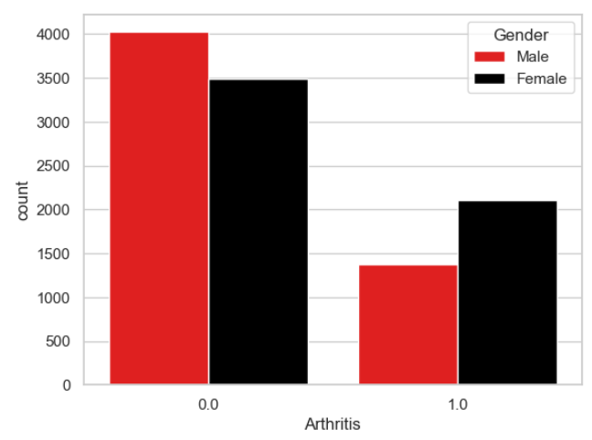

Slide 22

Heart Attack
Heart-Attack: Sudden blockage of blood flow to the heart muscle.
Leading cause of Deaths in Washington after cancer.
Approximately 11,500 people lose their lives and millions of dollars are spent in treatment.

Slide 23
Non-Modifiable Risk Factors:
Age
Gender
Family History
Genetics

Slide 24

Modifiable Risk Factors:
High Blood Pressure (Hypertension)
High Cholesterol
Smoking
Diabetes
Obesity
Physical Inactivity
Unhealthy Diet
Stress
Excessive Alcohol Consumption
Sleep Apnea
Drug Abuse
Inflammation

Slide 25
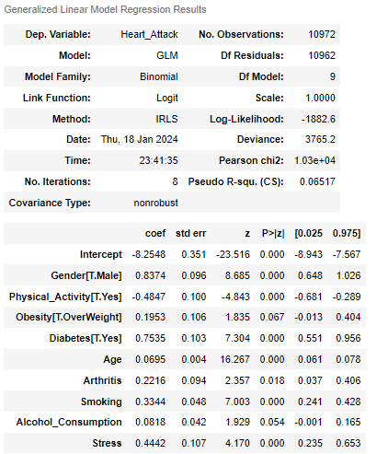
Logistics Regression

Slide 26

Interpretation
Gender: The male will have 0.83 units greater log odds for heart attack than the female, while holding the other variables in the model fixed. OR the males have 2.3 times higher odds of heart attack than females.
Physical_Activity: The Physically Active people will have 0.4847 units less log odds for heart attack than the Physically Inactive ones OR the physically active people will have 0.61 times lower odds of heart attack.
Obesity: The overweight people have 0.1953 units greater log odds for heart attack than normal people OR the overweight people have 1.21 times higher odds of heart attack.
Diabetes:The diabetic people have 0.7535 greater log odds for heart attack OR the diabetic people have 2.12 times higher odds of heart attack.

Slide 27
Interpretation
Age: With every increase in age by one year the log odd for heart attack increases by 0.0695 units log odds OR 1.07195 higher odds.
Arthritis: The people suffering from Arthritis have 0.2216 units more log odds than with the people without Arthritis issue OR 1.24 odds.
Smoking: The Smokers have 0.3344 units greater log odds for heart attack than the non smokers. OR 1.397 odds
Alcohol Consumption: The Drinkers have 0.0818 units higher log odds than non-drinkers OR 1.085 odds.
Stress: The people having Stress have 0.4442 more units log odds than those without stress OR 1.56 odds.

Slide 28
Conclusions:
In conclusion, this logistic regression analysis not only highlights the multifactorial nature of heart attack risks but also provides a data-driven foundation for developing targeted prevention strategies.
By addressing these key risk factors, we can take significant steps towards reducing the incidence and impact of heart attacks in Washington by educating people more about healthy life-style.

Slide 29

Thank You
For Your Attention
Visit Our Website
https://ranasherazshafi.carrd.co/

